Slide 1

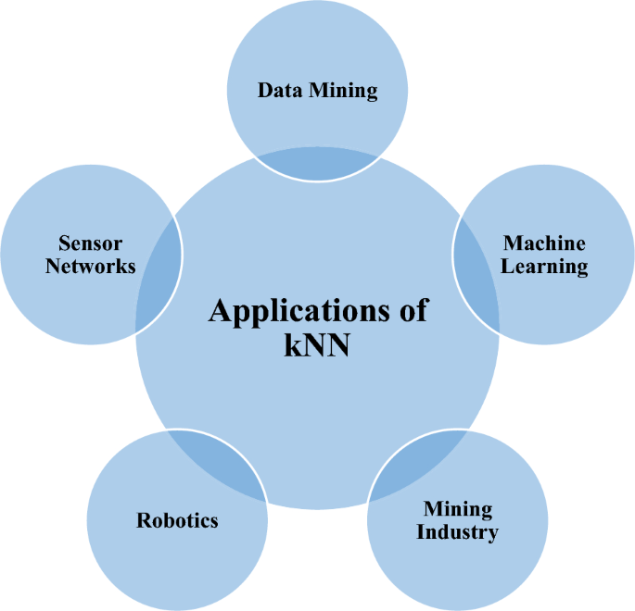
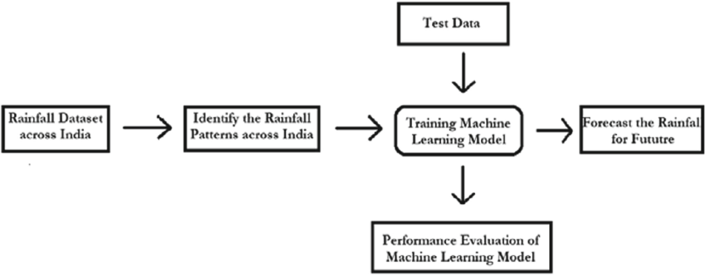
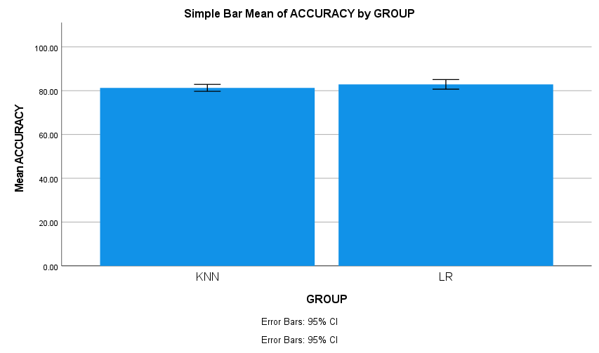
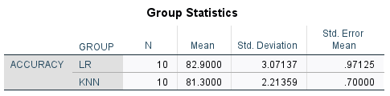
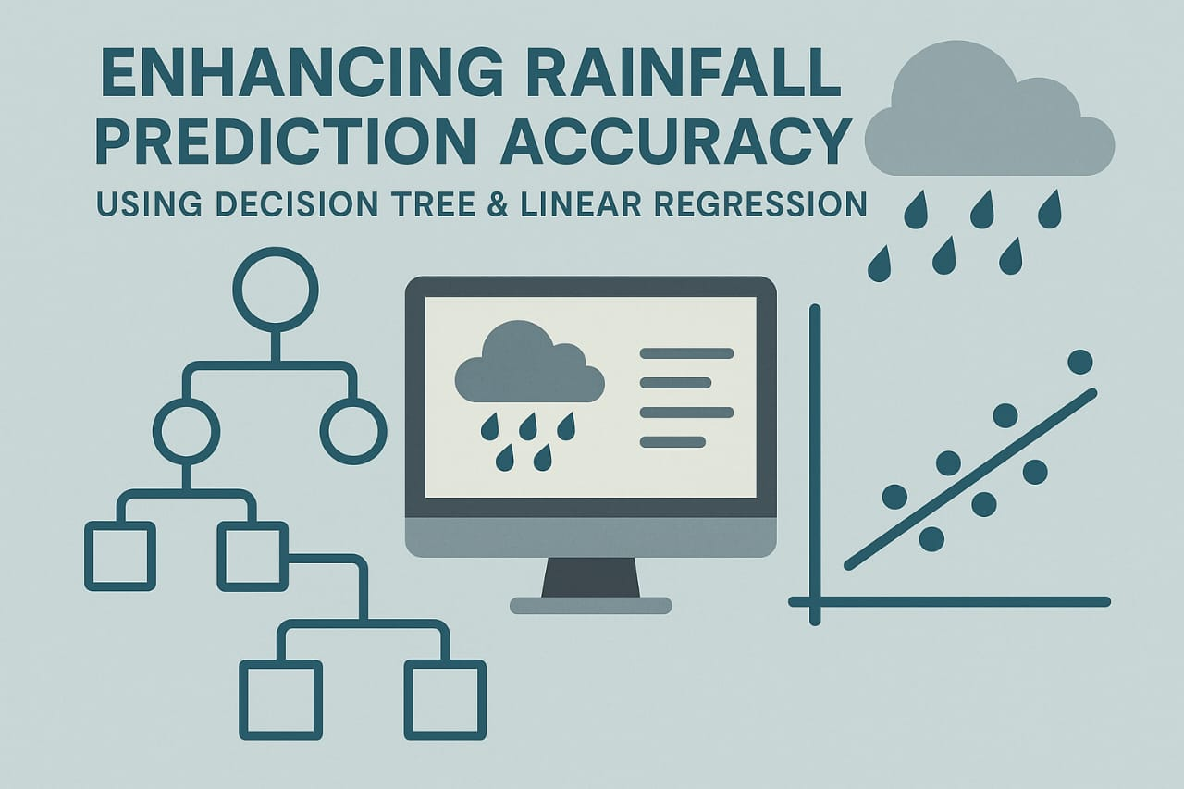
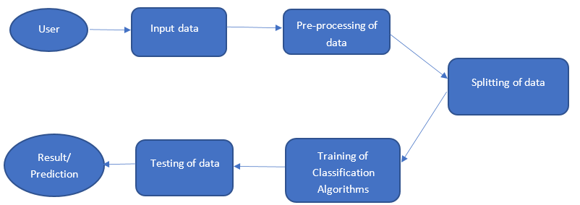
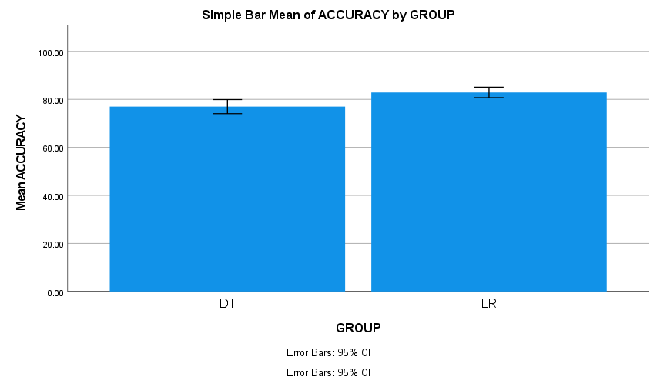
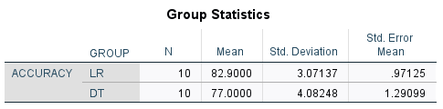
Register No: 192425221
Students Name: D .Devisri prasad
Guided By Dr. Ravisankar
Enhancing Rainfall Prediction Accuracy Using K-Nearest Neighbors(KNN) & Linear Regression
INTRODUCTION
Rainfall prediction plays a vital role in agriculture, disaster management,
and planning.
This study focuses on using K-Nearest Neighbors (KNN) and Linear
Regression for improved prediction accuracy.
Historical weather data is utilized to train and evaluate the models
for reliable forecasting.
MATERIALS AND METHODS
Historical weather data was collected and
preprocessed by handling missing values and
normalizing features.
K-Nearest Neighbors (KNN) and Linear Regression
models developed and tuned for rainfall prediction.
RESULTS
DISCUSSION AND CONCLUSION
Both KNN and Linear Regression showed potential in predicting rainfall, with KNN capturing non-linear patterns better.
Linear Regression provided interpretability but was limited by assuming linear relationships.
Combining these approaches can enhance prediction accuracy, aiding better weather forecasting and decision-making.
BIBLIOGRAPHY
This study utilized historical rainfall data from Kaggle and NOAA, and applied models using Scikit-learn and Pandas. Jain et al. (2014) explored ANN and linear regression for rainfall prediction, while Sharma & Sharma (2017) evaluated KNN and Naive Bayes models. Nayak et al. (2017) provided a broad review of machine learning techniques used in weather forecasting. Model accuracy was assessed using standard metrics, following guidelines from the World Meteorological Organization.
Enhancing Rainfall Prediction Accuracy Using Decision Tree & Linear Regression
INTRODUCTION
Accurate rainfall prediction is vital for agriculture and disaster
management.
This study uses Decision Tree and Linear Regression models
to improve prediction accuracy.
Historical weather data is analyzed to capture both linear
and complex rainfall patterns.
MATERIALS AND METHODS
Historical weather data with features like
temperature, humidity, and rainfall was
collected.
Data preprocessing included handling
missing values, encoding, and feature
scaling.
RESULTS
DISCUSSION AND CONCLUSION
Decision Tree effectively captured non-linear rainfall patterns, while Linear Regression modeled linear trends.
Combining both methods improved overall prediction accuracy compared to using either model alone.
These findings support the use of hybrid approaches for more reliable rainfall forecasting and better resource planning
BIBLIOGRAPHY
This project uses historical weather data from Kaggle and NOAA to implement Decision Tree and Linear Regression models for rainfall prediction. Model development and evaluation were carried out using Scikit-learn and Pandas. Jain et al. (2014) demonstrated the effectiveness of linear regression and neural networks in rainfall forecasting, while Nayak et al. (2017) reviewed machine learning techniques including Decision Trees for weather prediction. Methodological standards were guided by the World Meteorological Organization.

